Slide 1


QEI: Query Acceleration Can be Generic
And Efficient in the Cloud
Yifan Yuan¹, Yipeng Wang², Ren Wang²,
Rangeen Basu Roy Chowhury², Charlie Tai², Nam Sung Kim¹
¹UIUC, ²Intel
Notes:
Hi everyone! I’m Yifan Yuan, a PhD student of UIUC. Today I’m going to introduce our work QEI: query acceleration can be generic and efficient in the cloud. This is a joint work with Intel.

Slide 2

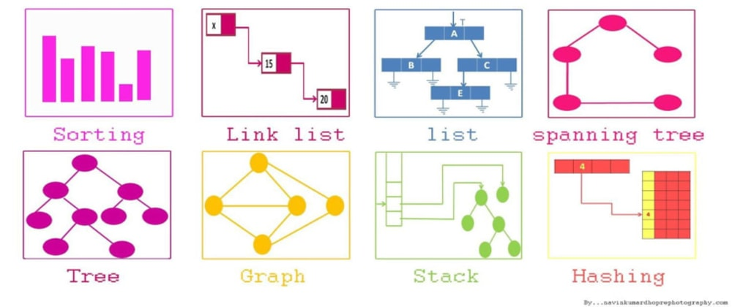
Motivation
Cloud applications are data-centric.
Data is organized in various data structures.
Query is the operation that retrieves a specific piece of data (value) from a data structure instance with a given key.
Notes:
In the big data era, there are lots of cloud applications dealing with tremendous amount of data, making them data-centric.
The data is organized in different data structures for timing and space trade-off.
To interact with these data structures, query is an important operation.
Here we define the query as the operation that retrieves data from a data structure with given information (key).

Slide 3
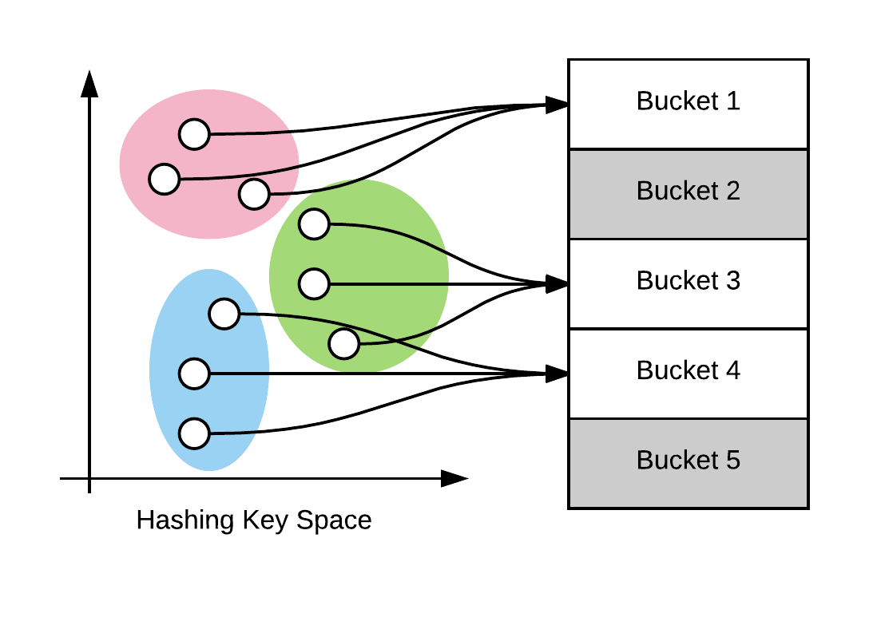





Motivation
Query is ubiquitous
, diverse, fine-grained …
Virtual switch -- hash table
Language runtime -- tree
Persistent key-value store (in-memory part) -- skip list
Search engine -- locality sensitive hash (a set of hash tables)
Intrusion detection system -- trie
Notes:
Data queries are everywhere, let’s see a few examples here.
First, a virtual switch can query a hash table for the forwarding information of each packet.
In intrusion detection system like Snort, a trie is queried to check whether the packet payload matches with any rules of malicious content.
Runtime system for managed languages such as JVM use tree to maintain the live objects and querying the tree can identify the dead object during the garbage collection.
In key-value store like RocksDB, the in-memory table is organized in skip list to get the recent key-value pairs very fast.
Lastly, in the search engine, locality-sensitive hashing -- a series of hash tables -- is used to search for similar items for given input.
From these examples, we can also say query is diverse across data structures, and is very fine-grained operation.

Slide 4
Motivation
Query is ubiquitous, diverse, fine-grained, but expensive.
Our goal: versatile accelerator with low overhead.
Notes:
However, we find the query operation is actually quite expensive in total execution time.
Recall the five examples we just mentioned, this chart shows that the data query operations can take 23~44% of the total CPU time within a server.
More specifically, they are bounded by memory access, data-dependent branches, and a large amount of dynamic instructions.
This motivates us to design acceleration solution that significantly facilitates various data queries with a low overhead.

Slide 5
Abstracting query operations
Query operations have lots in common
2 inputs (key, address of the data structure)
1 output (value)
5 steps:
Notes:
To achieve this, the first thing is to find fundamental abstractions for different queries operations.
Luckily, we find that queries have lots in common, that is, 2 inputs, 1 output, and 5 steps.
The first input is key to be queried and the second input is a pointer to the data structure or say the starting address.
The Output the queried result, which can be the data itself or pointer to the data.
For the first step, we receive the key and starting address, then we hash the key or use the key directly.
With hashed code or the key, we find the starting item in the data structure, the item can be a bucket entry in hash tables, or a node in the linked list/tree.
From the item, we read out the stored key to compare against the input key, whether the two match.
If two match, we send back the item value as the result; otherwise, we go back and find the next item to match.
So on and so forth, until we find a match or no match exist.

Slide 6
Abstracting query operations
Example: linked list
Notes:
Let me give a simple example: the query in the linked list.
The node structure is the item contains key and value.
To begin the query, we first receive the key and starting address, then we skip the hashing step, and then we use the root node as the first item to match.
If the item key matches input key, we return the item value as the result.
Otherwise, we move to the next node to match, until we find a match, or no match exists.

Slide 7
Abstracting query operations
Such a 5-step abstraction makes it nature to map to configurable finite automaton (CFA).
Hardware-friendly, low-cost, flexible.
Example: linked list
Notes:
Mapping to hardware, such a 5-step abstraction makes it good fit for configurable finite automaton or CFA, which is hardware-friendly, low-cost and flexible.
For the same example of linked list, we have six states and eight transitions.
Starting from IDLE state, a query instruction will trigger the first transition, during which memory requests will be issued for reading both input key and the root node.
Depending on which order the memory request is returned, the state will change following two branches (2)(4) or (3)(5).
If node is received first, then we go through transition (2) to MEM.K and waits for the key. Once the key arrives, we go through transition (4) to do the key comparison.
On contrary, if the key is received first, we go through the other branch.
At COMP state, if the comparison result is “mismatch”, we goes back to “MEM.N” state and to request for the next node.
If the result is match, the we got through the transition (7) and (8) to send back the node value.

Slide 8
Designing QEI accelerator
In-flight queries
information
Arithmetic,
Comparison…
State transition
rules
Reconfigurable via firmware update.
Notes:
With the query abstraction and CFA model, we design the QEI accelerator.
As shown in this diagram, the accelerator has 3 essential components.
First, the query state table store the basic information and states for all in-flight queries. This is to enable the out-of-order execution of multiple queries.
Second, the CFA execution engine store the state transition rules of each CFA, and applies them to the corresponding queries.
Last, the data processing unit deals with specific sub-operations, such as arithmetic and comparisons for the data from the memory/cache.
Note that since all the states are stored in the QST, the CFA execution engine and data processing unit are stateless, and can be time-multiplexed across queries.
The QEI accelerator is reconfigurable for new data structure support. The flow is similar to a regular firmware update.

Slide 9
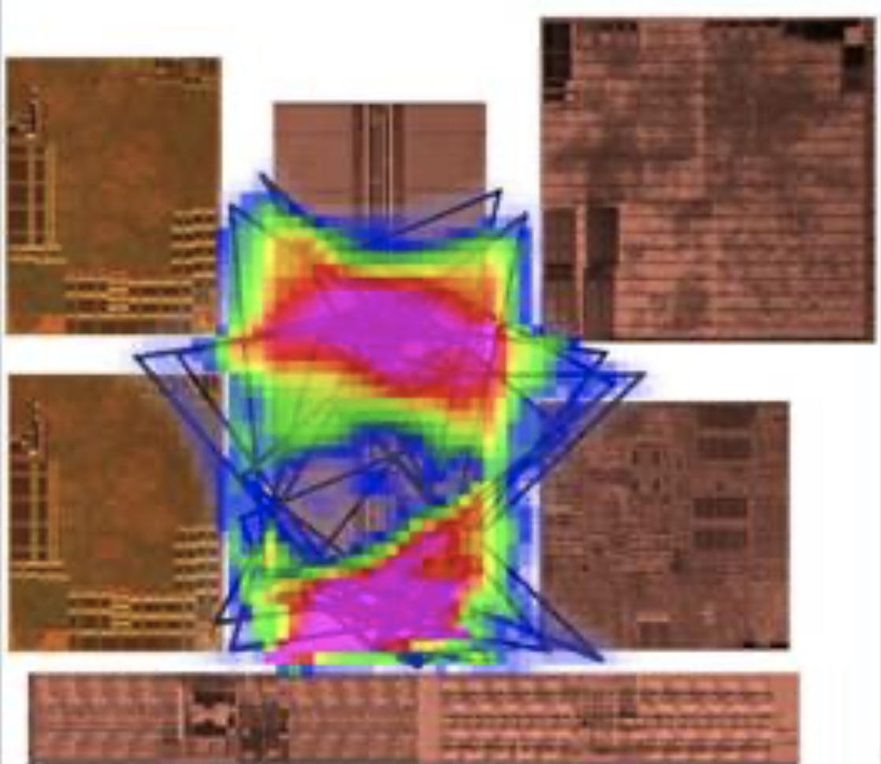

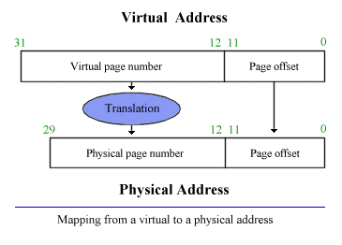
Placing the accelerator: Challenges
Scalability: more accelerators and more in-flight queries,
no congestion/hotspot.
Latency: close to CPU core, avoiding long core-accelerator and accelerator-data communication.
Cost: virtual-physical memory address translation is inevitable, but TLB/MMU is costly (power/area, coherence, etc.).
Notes:
Having the accelerator design, we now consider how we should place it into the CPU.
In general, there are 3 major challenges here.
The first one is scalability. Today’s server CPU often consists of tens of cores, to accelerate queries of multiple cores, we need scale out the accelerator without creating hotspot.
The second one is latency. As we mentioned before, queries are fine-grained and latency-sensitive. If the accelerator is far from CPU core, the overall performance will be affected.
The last one is cost. An essential factor here is address translation. Every memory access in a query requires address translation. However, it is costly to both adding and maintaining component like TLB.

Slide 10
Placing the accelerator
Device-based: dedicated accelerator design via interface.
Long latency
Core-integrated scheme: share L2-TLB with core, while leaving the data-heavy comparison operations close to LLC slices.
CHA (cache and home agent)-based: accelerator to LLC completely.
No address translation capability
Notes:
The existing placement schemes have their drawbacks.
First, the accelerator can be regarded as an independent device, connected via standard interface like CAPI and CXL. And the major issue is interface latency, even if it’s in the coherence domain.
Second, the accelerator can be be placed into each last-level cache slice. It solves the scalability issue and latency issue. However, the LLC doesn’t have the address translation capability, and going back and forth to core’s TLB is costly.
In this work, we propose a third hybrid solution that keeps the control logic part near L2-TLB, while conducting the data-intensive part – the comparison close to LLC slices. This solution has a good scalability through its distributed deployment, and achieves low latency and cost by share existing TLB resources. Hence, it keeps a fine balance between the 3 challenges with good performance.

Slide 11
More in the paper
All-in-one query instructions.
Reconfigurability.
Exception, interrupt, security handling.
….
Notes:
There are also other aspects of our design. Please check our paper for more details.

Slide 12
Methodology
Simulator: We use snipper to evaluate QEI on a modern x86 CPU with different schemes.
Benchmarks: DPDK (hash table), JVM (tree), RocksDB (skip list), Snort (trie), FLANN (LSH)
Replace the query routine with the QEI instruction.
Power and area: CACTI and McPAT.
Notes:
To evaluate our design, we implement the QEI accelerator in snipper simulator, and run five representative cloud workloads.
We use CACTI and McPAT for power and area evaluation.

Slide 13
Methodology
Evaluated schemes:
Baseline: pure software solution.
CHA-noTLB: in-LLC accelerator, back to core for address translation.
CHA-TLB: add TLBs in LLC.
Device-direct: independent accelerator on NoC.
Device-indirect: independent accelerator on interface.
Core-integrated: hybrid placement.
Notes:
We also compare 5 placement schemes.

Slide 14
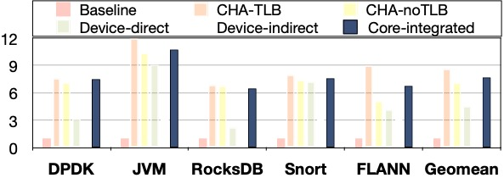
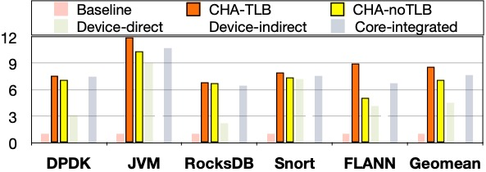
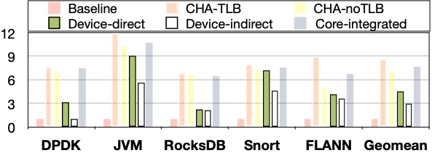
Evaluation
CHA-TLB is the best.
Core-integrated achieves comparable performance with small gap to CHA-based ones.
Device-based typically not good (due to the long latency without batching).
Notes:
We compare software baseline with 5 different integration schemes for the query speedup.
First, we find that the CHA-based schemes always have first-class performance. Specifically, if we add a TLB inside the LLC slice, we can achieve highest speedup here. If we go to core’s TLB for address translation, there will be a moderate performance drop.
Second, the device-based schemes, either directly connected to the core or indirectly through an interface, suffer a high latency and thus don’t perform well. Batching the queries may mitigate this problem for throughput but will worsen the latency performance.
Last, our core-integrated scheme has the No.2 performance, which is just 8% lower than CHA-TLB.

Slide 15
Evaluation
Core-integrated is much cheaper and practical.
Notes:
We then compare the overhead of such schemes.
Obviously, adding TLBs at LLC is not a cheap design, around 3x more costly than core-integrated design.
The device model also has a higher power and area cost due to the overhead of interfacing and address translation.
Hence, we prove that our scheme is practical to be integrated in a CPU.

Slide 16
Conclusion
Accelerating fine-grained, latency-sensitive query operations is critical for cloud applications and infrastructures.
QEI achieves the goal of generic and efficient query acceleration by CFA-based architecture and hybrid integration scheme.
Evaluation with 5 representative cloud workloads demonstrates QEI’s outstanding performance and low cost.
Notes:
To recap, in this work, we identify the query operation as a critical and expensive part in the cloud.
Based on the observation of the common characteristics of query operations, we design QEI accelerator with CFA model to achieve generic and efficient query acceleration.
Our evaluation on several representative cloud workloads shows QEI’s significant benefits.

Slide 17

Contact the author: yifany3@Illinois.edu, https://yifanyuan3.github.io
This presentation and recording belong to the authors. No distribution is allowed without the authors’ permission.
Notes:
Thanks for your listening. Please feel free to contact me for any questions.

Slide 18
Evaluation
Dynamic instruction count compared to software queries.
Our accelerator can significantly reduce executed instructions by cores, thus relieving front-end and i-cache pressure.

